Slide 1
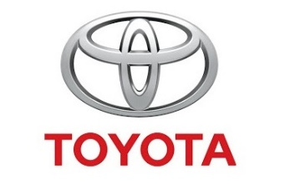
TESTIMONIAL
TOYOTA
Toyota Denmark imports and markets a diverse portfolio of Toyota vehicles in Denmark.
After having implemented the iPhone as the company phone in 2011, Toyota Denmark required a strategic product for their phones that would provide all the functionality that the employees knew from fixed line to their mobile phones.
The company wanted to benefit from having introduced the iPhone as a company phone.
Zylinc’s Solution
Benefits – Enterprise
Benefits – User
Toyota Denmark has chosen Zylinc Attandant Console and Zylinc Mobile Operator as their strategic products.
The solutions are being used by Toyota Denmark’s approx. 85 agents, and they are provided with a continuous overview of each other’s availability and can relieve each other during breaks or long call queues.
Agents are also able to view their own or other agents’ calendars, contact details, as well as a real-time availability overview of all colleagues.
Zylinc’s solutions fulfill the expectations and needs of the agents.
Agent response times were reduced significantly.
The solutions also facilitate collaboration between the company’s many agents.
With Zylinc’s solutions, agents are able to find and transfer calls to the employee who is best equipped to answer a customer’s call.
Agents are able to create a meeting quickly and easily in their calendar while on the move.
The solutions also make it easy to search for both individual colleagues and their skills across the company.
Notes:
1

